Slide 1


MIECO: Metabolite Identification Evidence Codes
Daniel Schober
Steffen Neumann

Slide 2
Contents
Project setting
Metabolite Identification Schemes
Review state of the art
MI Schemes
Terminologies/ontologies
Why yet another ontology?
Efforts we can re-use
ECO
Our Use Case
Basic MI evidence patterns
MIECO overview
MIECO Use Case Example

Slide 3
Project environment
PhenoMeNal H2020 EU Project
Phenome and Metabolome aNalysis
http://phenomenal-h2020.eu/home/
e-Infrastructure
processing, analysis & information-mining of metabolomics phenotyping data
Contribute to WP 8 Data standards
D8.4: Signal processing and analysis data exchange format
D8.4.1: specifications for derived data matrices and terminology for description of analysis & statistical results (M24)

Slide 4
MetSoc Ident Task force
Metabolomics Society: Metabolite Identification Task Group
Objective
update 4 Level reporting standard by adding increased granularity on instruments, data & bioinformatics resources

Slide 5
What are we talking about ?
Metabolite Assignments
assertions on the involvement of a compound under investigation
Metabolite Characterisation
Compoubnd is of a certain backbone structure (Identification on the class level).
Metabolite Identification
totally defined molecular structure (Identification on the individual level)

Slide 6
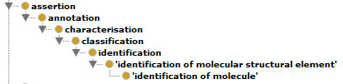
Assertions
A simple is-a taxonomy

Slide 7
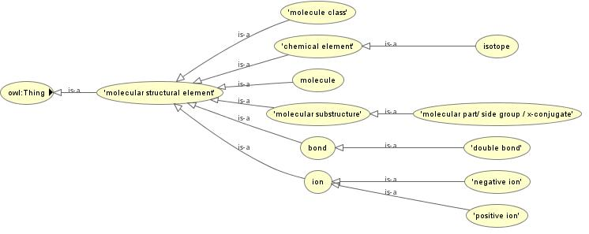
Molecular Structures
http://phenomenal-h2020.eu/home/workpackages/wp8-data-provenance-compliance-and-integrity/

Slide 8
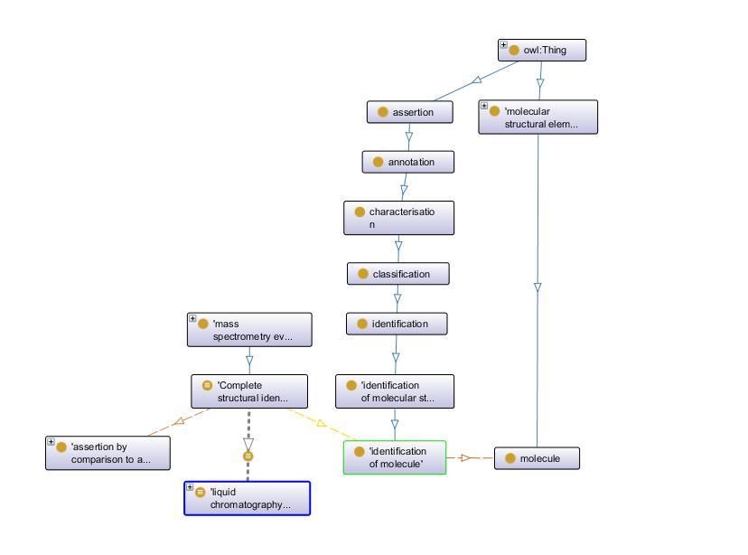

Slide 9
Data Quality
Data Quality is an important provenance data
Audit trail allows to judge data reliability
based on source data & transformation indicators
Foundation for Trust and Evaluation
Drives decisions to re-use Data

Slide 10
Confidence in Identification statements
levels of confidence in identification statements
are varying greatly between studies
difficult to communicate to data users in a concise and accurate fashion

Slide 11
Scopeing
General Constraints
Retain mappings to earlier Schemes for downward compatibility
Simple set-up so non-IT users can use it
Low entry hurdle for bio community
Easy to adopt & use

Slide 12
Import & X-Refs
Multiple Options
MIREOT
Owl:import
http://labs.mondeca.com/protolov/

Slide 13
Existing Standards
EU Directive 96/23/EC concerning performance of analytical methods & the interpretation of results (C(2002) 3044)
Too complex → provide little practical utility

Slide 14
Chebi/ont https://www.ebi.ac.uk/chebi/userManualForward.do;jsessionid=CCA5DEB227EC2F848F7A8DDF3D4D36DF?printerFriendlyView=true#Parents%20and%20Children%20View
Alle Einträge werden wie folgt mit einem Sterne-System eingestuft:
3 Sterne: Die Entität wurde manuell durch das ChEBI Team annotiert.
2 Sterne: Die Entität wurde manuell durch das ChEMBL Projekt oder durch einen ChEBI Einreicher annotiert.
1 Stern: Die Entität stellt einen vorläufigen Eintrag dar, welcher automatisch von einer Datenquelle geladen wurde aber nicht manuell annotiert wurde.
Die Abwesenheit von Sternen bedeutet, dass der Eintrag entweder gelöscht wurde oder obsolet ist.
Aber auch
5.4 Status
Der Status eines Eintrags oder einer Beziehung wird in der denormalisierten Baumansicht wie folgt dargestellt:
Kontrolliert
Einträge und Beziehungen welche von den Kuratoren eingehend überprüft wurden sind in der Baumansicht blau gefärbt.
Nicht kontrolliert
Einträge und Beziehungen mit nur vorläufigem Status sind in der Baumansicht grau gefärbt. Bei solchen Einträgen und Beziehungen sollte stets bedacht werden, dass sie noch nicht von einem Kurator kontrolliert wurden. Wenn über die Baumansicht auf sie zugegriffen wird, tragen solche Einträge zur Warnung die Überschrift "Preliminary ChEBI Entry".

Slide 15




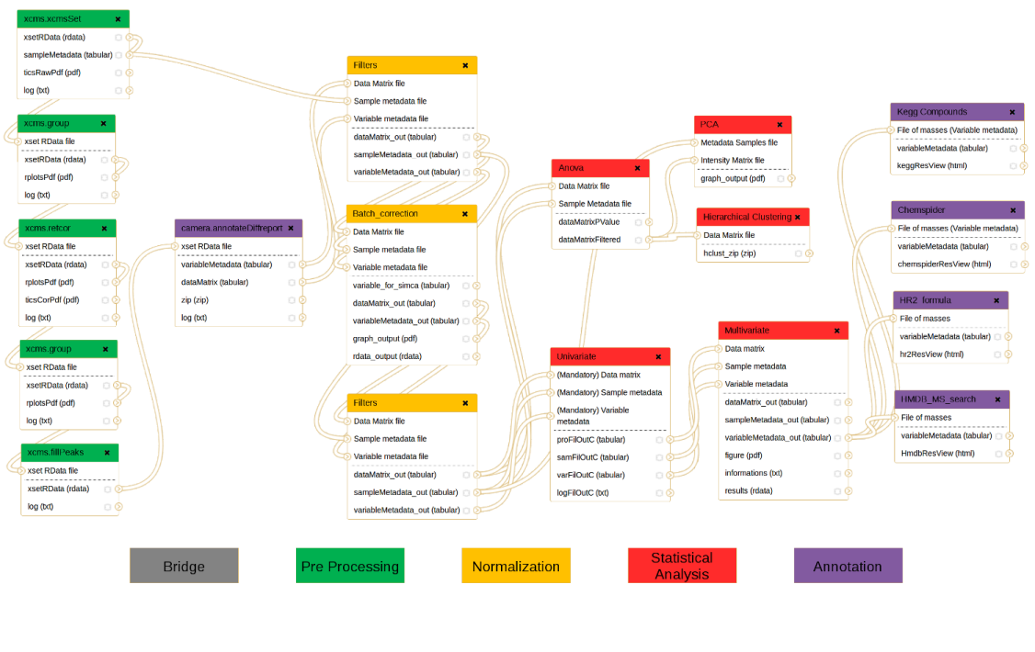



Publication Workflow
Package the data for standards-compliant dissemination and reporting
http://www.isatools.org/
http://workflow4metabolomics.org

Slide 16
Next tasks
Write paper
How to best impose the requirement to use reporting standards for metabolite identification ?
Recommend publishers & repositories to enforce usage
i.e. Springer Metabolomics & Metabolights

Slide 17
Autogenerate Evidence Codes from standardized data ?
Text mining to derive ECOs from paper methods sec
or ideally formal future workflow specifications
Transition into Quantitative background model for numeric evaluation
i.e. setting evidence thresholds for quality analysis

Slide 18
Resources
Git
https://github.com/DSchober/MIECO
Gdoc
https://docs.google.com/document/d/1JHw7FntqtntZV0qoWsFmcOLcHlM2wv4jt4-ccLUgZNU/edit#

Slide 19
Acknowledgements
PhenoMeNal is funded by European Commission's Horizon2020 programme, grant agreement number 654241
Metabolomics Society: Metabolite Identification Task Group
Nadine Strehmel

Slide 20
Thank you!
dschober@ipb-halle.de

Slide 21
Overview of Use Cases
Use Case | Partner | Cohort Size | Assays | Workflow | Implementation
MESA | ICL | 4,000 | NMR, LC/MS | NMR: calibration, alignment, normalisation, statistics MS: Data conversion, feature detection, alignment, deconvolution, QC filtering, normalisation, batch correction | Matlab, Octave, R
CoLaus | SIB | 6,733 | NMR, Genotyping | NMR processing, MetaboMatching (Genotype correlation) | Octave
Uppsala | UU | 120 | LC/MS | Data conversion, feature detection, alignment, blank removal, feature selection | OpenMS
MetaboHUB | CEA | 183 | LC/MS | Data conversion, feature detection, alignment, univariate and multivariate statistics | R
¹³C tracer cell line | UB | -- | GC/MS | Data import, Natural Isotope abundance correction, Label enrichment, SBML | R, Python

Slide 22
To set the Frame
A survey of data provenance in e-scienceYL Simmhan, B Plale, D Gannon
ACM Sigmod Record 34 (3), 31-36

Slide 23
5 Level scheme
Schymansky in expansion to Sumner

Slide 24
Use Case: Example Table
no | annotation | VL¹ | Lit.² | elemental comp. | RT_{r} [s] |  | #exchange protons | ESI(+)³ |  |  |  | ESI(-)³
 |  |  |  |  |  |  |  | Quantif ion type | m/z found | ⏐err⏐ ppm | mS⁴ | ion type | m/z found | ⏐err⏐ ppm | mS⁴
2 | Guanosine | S | - | C₁₀H₁₃N₅O₅ | 46 |  | 6 | [M+H]⁺ | 284.0972 | 6.2 | 84 | [M-H]⁻ | 282.0838 | 2.1 | 29
2 | Guanosine | Complete structural identification by LCMS similarity to authentic reference standard | - | Characterisation by Sum formula | Characterisation by LC RT value |  |  | Characterisation by collision induced dissociation (CID) MS with mass and isotope pattern of quasi-molecular fragment ion in positive ESI mode | Characterisation by m/z value in MS2 | 6.2 | 84 | Characterisation by collision induced dissociation (CID) MS with mass and isotope pattern of quasi-molecular fragment ion in negative ESI mode | Characterisation by m/z value in MS2 | 2.1 | 29
20 | H-Val-Leu-OH | S,L | (1) | C₁₁H₂₂N₂O₃ | 159 |  | 4 | [M+H]⁺ | 231.1697 | 2.6 | 4 | [M-H]⁻ | 229.1537 | 8.9 | 9
20 | H-Val-Leu-OH | Complete structural identification by LCMS similarity to authentic reference standard | Characterisation by LCMS similarity to literature reference | Characterisation by Sum formula | Characterisation by LC RT value |  |  | Characterisation by collision induced dissociation (CID) MS with mass and isotope pattern of quasi-molecular fragment ion in positive ESI mode | Characterisation by m/z value in MS2 | 2.6 | 4 | Characterisation by collision induced dissociation (CID) MS with mass and isotope pattern of quasi-molecular fragment ion in negative ESI mode | Characterisation by m/z value in MS2 | 8.9 | 9
43 | I3CH₂NH₂ | S,L | (4) | C₉H₁₀N₂ | 111 |  | 1b | [M+H-NH₃]⁺ | 130.0646 | 3.8 | 3 | - | - | - | -
50 | Unknown indole derivative | I | - | C₁₀H₉NO₃ | 391 |  | _a | [M+H]⁺ | 192.0651 | 2.1 | 3 | [M-H]⁻ | 190.0498 | 10.8 | 22
57 | G(8-O-4)S^{Glycerol} | I | - | C₂₁H₂₈O₁₀ | 188/192 |  | 6 | - | - | - | - | [M-H]⁻ | 439.1567 | 9.8 | 115
76 | Unknown oligolignol | I | - | C₄₁H₄₆O₂₀ | 300 |  | 8 | [M+Na]⁺ | 881.2497 | 2.5 | 74 | [M-H]⁻ | 857.2455 | 6.4 | 69
85 | Fatty acid derivative | I | - | C₁₈H₃₀O₄ | 634 |  | 2 | - | - | - | - | [M-H]⁻ | 309.2048 | 7.4 | 86
88 | C₄H₁₀O Malonyl-Hex | I | - | C₁₃H₂₂O₉ | 232 |  | 4 | [M+Na]⁺ | 345.1144 | 1.2 | 30 | [M-H-CO₂]⁻ | 277.1274 | 6.8 | 24

Slide 25
no | annotation | MIECO Assertion | MIECO Assertion | MIECO Assertion | MIECO Assertion |  | #exchange protons | ESI(+)³ |  |  |  | ESI(-)³
 |  |  |  |  |  |  |  | MIECO Assertion | MIECO Assertion | ⏐err⏐ ppm | mS⁴ | MIECO Assertion | MIECO Assertion | ⏐err⏐ ppm | mS⁴
2 | Guanosine | Complete structural identification by LCMS similarity to authentic reference standard | - | Characterisation by Sum formula | Characterisation by LC RT value |  |  | Characterisation by collision induced dissociation (CID) MS with mass and isotope pattern of quasi-molecular fragment ion in positive ESI mode | Characterisation by m/z value in MS2 | 6.2 | 84 | Characterisation by collision induced dissociation (CID) MS with mass and isotope pattern of quasi-molecular fragment ion in negative ESI mode | Characterisation by m/z value in MS2 | 2.1 | 29
20 | H-Val-Leu-OH | Complete structural identification by LCMS similarity to authentic reference standard | Characterisation by LCMS similarity to literature reference | Characterisation by Sum formula | Characterisation by LC RT value |  |  | Characterisation by collision induced dissociation (CID) MS with mass and isotope pattern of quasi-molecular fragment ion in positive ESI mode | Characterisation by m/z value in MS2 | 2.6 | 4 | Characterisation by collision induced dissociation (CID) MS with mass and isotope pattern of quasi-molecular fragment ion in negative ESI mode | Characterisation by m/z value in MS2 | 8.9 | 9

Slide 26
http://de.slideshare.net/egonw/metware
Egon Willighagens old approach.
My Gdoc at
https://docs.google.com/document/d/1JHw7FntqtntZV0qoWsFmcOLcHlM2wv4jt4-ccLUgZNU/edit#

Slide 27
Root exudate UseCase MTBLS160
http://www.ebi.ac.uk/metabolights/reviewerLgTnoHUrFb
Strehmel N, Bottcher C, Schmidt S, Scheel D (2014) Profiling of secondary metabolites in root exudates of Arabidopsis thaliana. Phytochemistry 108:35–46CrossRefPubMed

Slide 28
Recently WP 8 participants have started looking into an ontology-based metabolite identification and evidence scheme based on Sumner et al (2014) and the Evidence Code Ontology (http://www.evidenceontology.org/), which will be a handy asset in judging data provenance and reliability of identification assertions in the future, i.e. allowing to set confidence threasholds for search and retrieval tasks.
Sumner L, Lei Z, Nikolau BJ, Saito K, Roessner U, Trengove R (2014): Proposed quantitative and alphanumeric metabolite identification metrics. Metabolomics 10:1047–1049. doi:10.1007/s11306-014-0739-6.

Slide 29
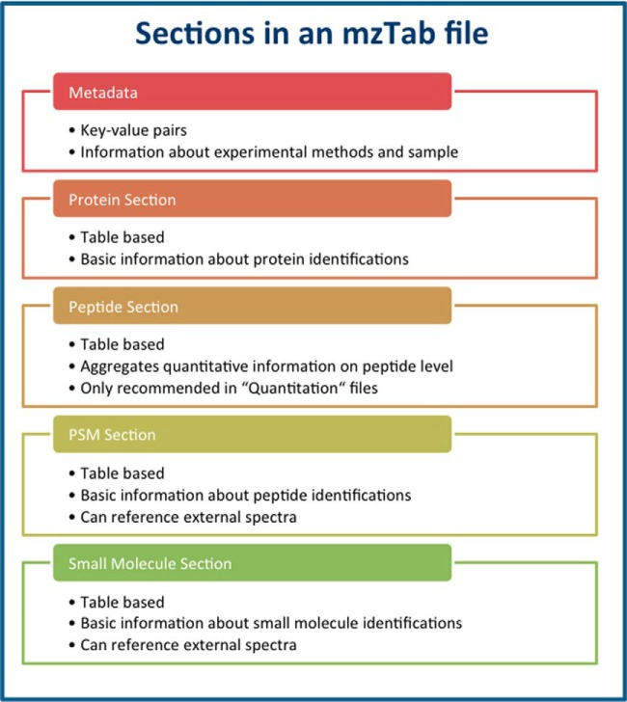
mzTab

Slide 30
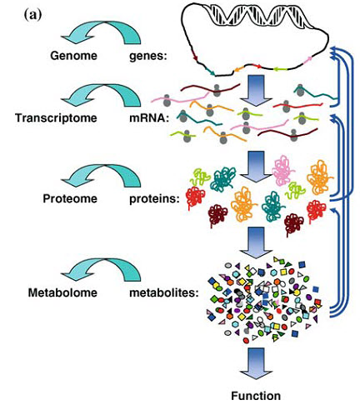
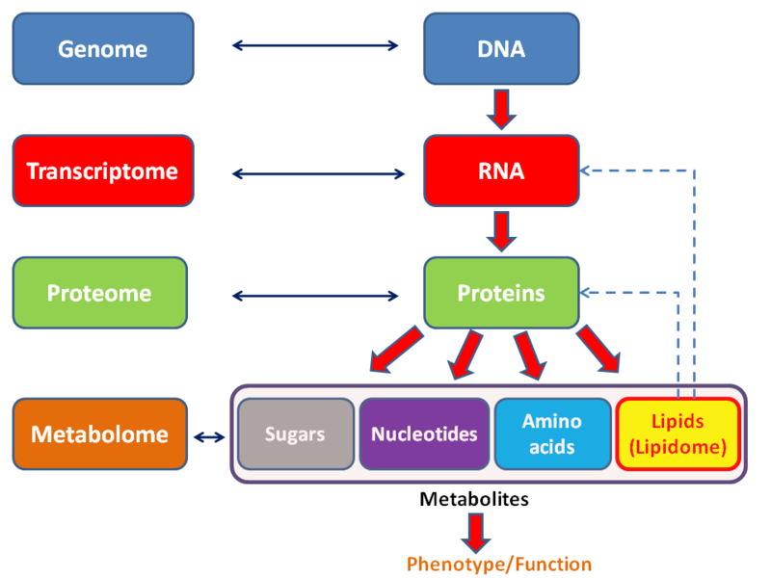

Slide 31
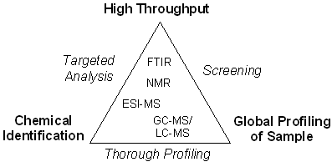
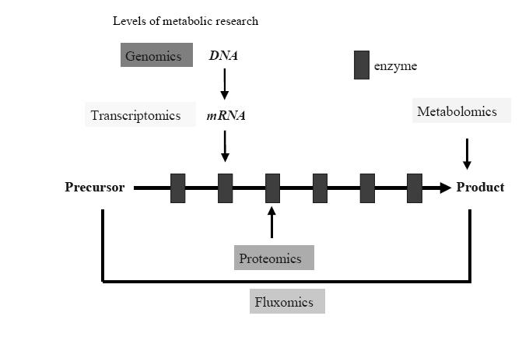

Slide 32
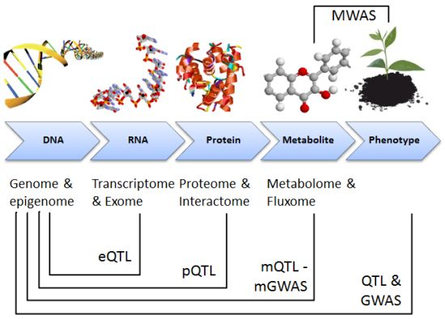

Slide 33
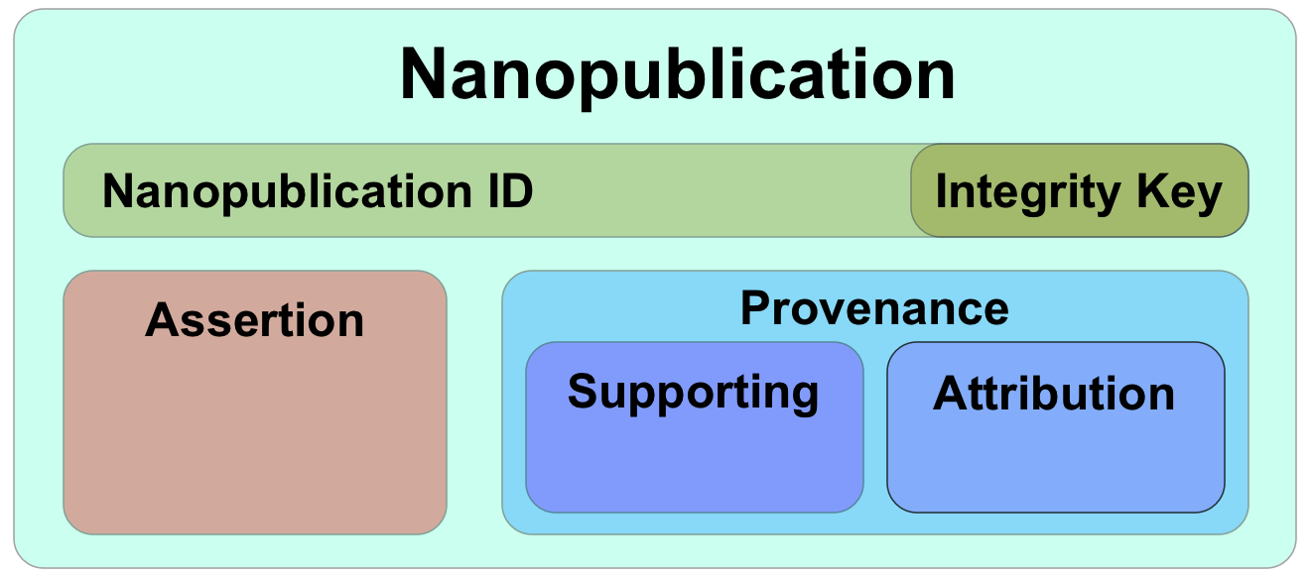

Slide 34
